Slide 1

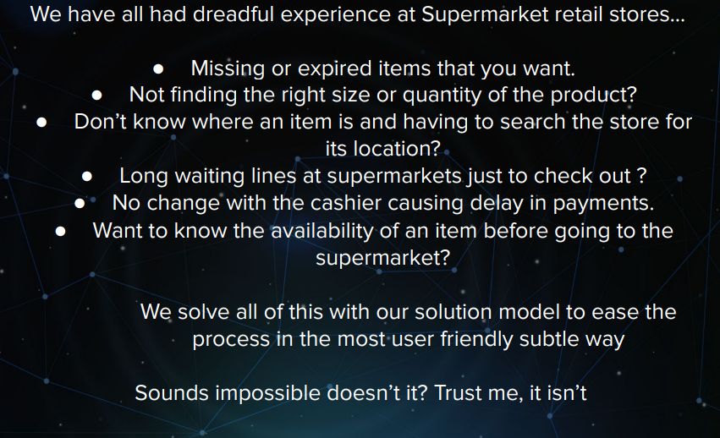

Slide 2
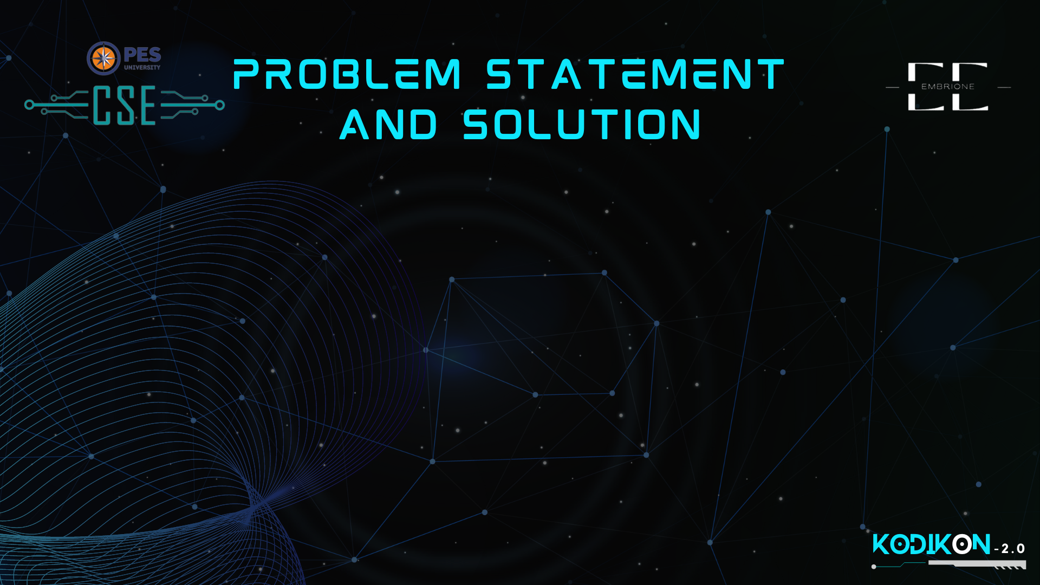
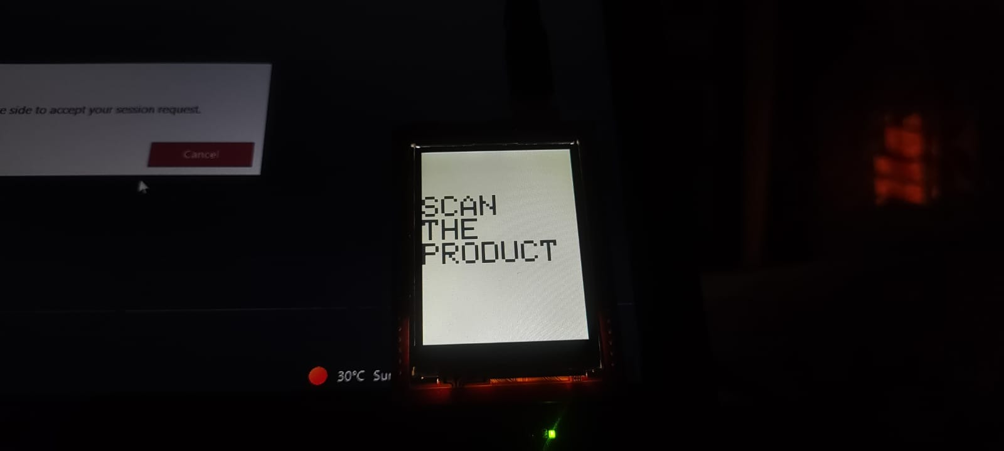
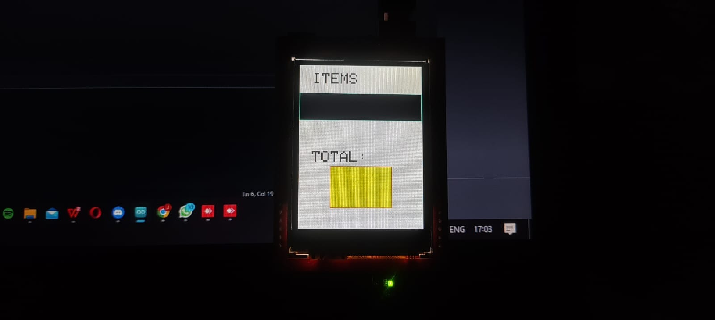

Slide 3
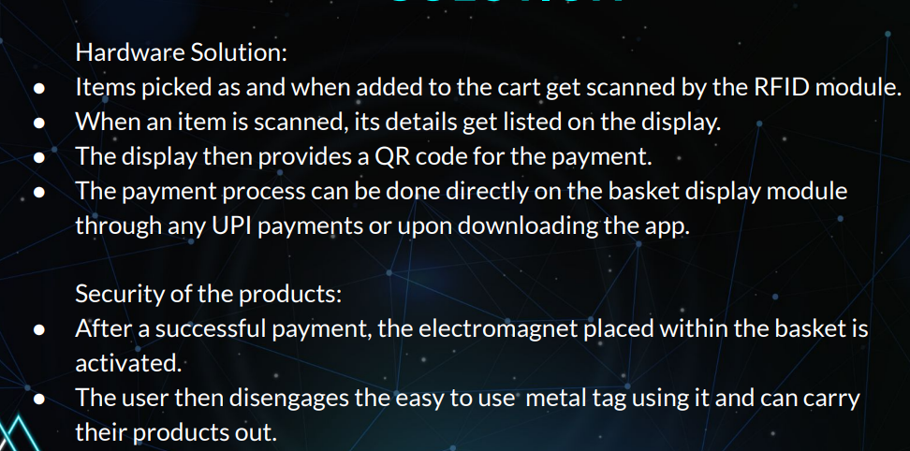

Slide 4
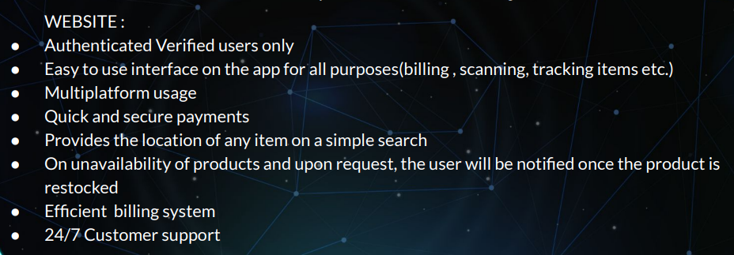
Our decision Tree model currently helps us decide what products are going below the minimum threshold so therefore alerting the owner that he has to Restock the item.

Slide 5
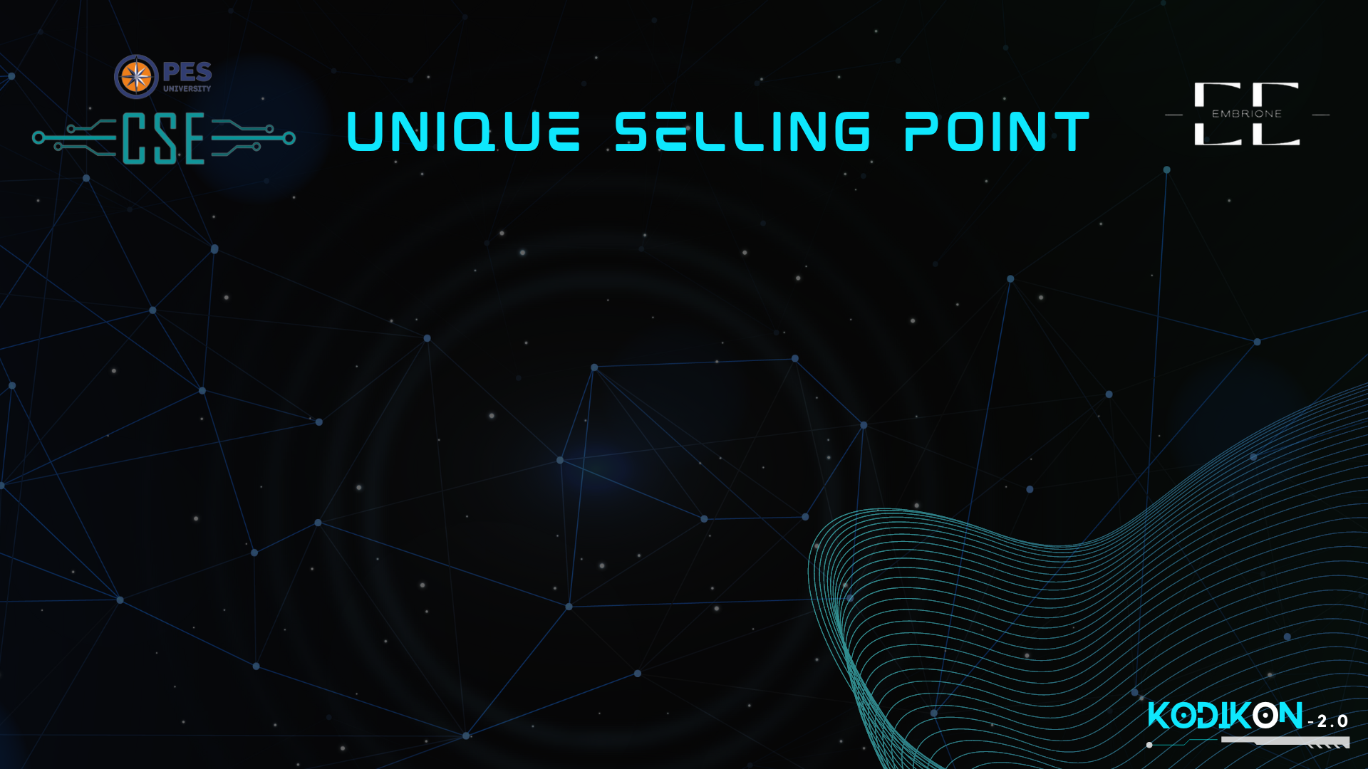
Convenience: The supermarket could be open 24/7, allowing customers to shop whenever is most convenient for them. Additionally, the automated system could allow for a faster and more streamlined shopping experience, without the need to wait in long checkout lines or interact with staff.
We show what items are available in the store ; LIVE so the user knows if what they want is currently available
Sustainability: The automated system could also track and display the environmental impact of each product, helping customers make more informed choices.
Cost savings: The automated system could help keep costs low by reducing the need for staffing and optimizing inventory management. These savings could be passed on to customers in the form of lower prices or more frequent promotions and discounts

Slide 6

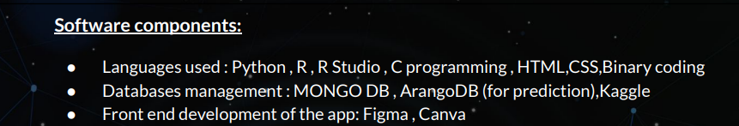
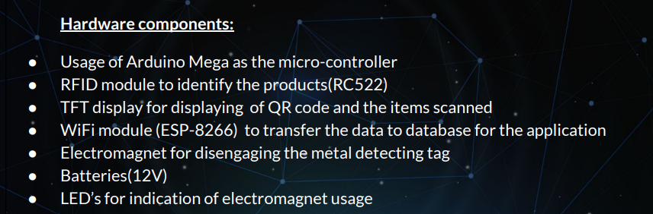

Slide 7

The automated system could help keep the costs low by reducing the need for staffing as the whole cashier system is eliminated
These savings can be passed on as discounts to the customers hence attracting more customers.
AD revenue
Since we will be operating 24/7 we will be getting more customers
Since we have a Decision making model that will tell when an item is below a certain threshold we can Restock accordingly as per the data and not order in excess.

Slide 8


Automation of stores using our technology in every mid-to high end retail marketer
Security Feature:
We want to add electromagnets to dissolve the issue of theft in retail supermarkets.
A way to delete an item from the bill as we remove it from the basket.
Implement RFID sensor near the electromagnet to detect if the item is billed or not to prevent theft.
Automate the retail as much as like Fast -Tag as the user passes through the exit the money sum is subtracted from the users bank account.
To publish a domain so that we can directly access the payment gateway by scanning our QR code generated on display
ML model to use a wider dataset like as of a year and analyse which products sell at which time more.

